Slide 1
STUDIES TO DATE
INSIGHTS
UXR ASSIMILATION CONCEPTS
10.15
-Studies to date
-High level insights
-UXR Assimilation
Concepts
Search A/B Competitive Test (Complete)
Checkout 2.0 Milestone 1 (In Progress)
Sports Category page A/B Concept Test (in Progress)
UX Research Update
Search – See Executive Summary
There’s a 95% chance that desktop users will prefer Vivid Seats over Seat Geek.
However, there’s a 99.9% chance that Desktop Users would prefer StubHub and Ticketmaster over Vivid Seats.
Elements of A Test Plan (Simple, non A/B)
Elements of a Good Testing Task

Slide 2
High Level Insights
Executive Summary + Some Key Slides

Slide 3
EXECUTIVE SUMMARY
GOAL
Inform and optimize designs in order to reduce risk and improve usability of the homepage search experience for event ticket purchasers on the mobile (Responsive Web) & Desktop, B2C, Homepage Search Experience.
METHOD
Competitive A/B Unmoderated Usability Test, Within-Subject Design
Competitors counterbalanced* against Vivid Seats: StubHub, Ticketmaster, Seat Geek
Devices counterbalanced: Mobile Responsive Web, Desktop Web
All participants (n = 60) were asked about various search motivations and goals, and prompted with the same 2 scenarios tasks, starting from the homepage of either Vivid Seats or one other competitor. Information salience was tested via confidence self-report and then a memory test proposition. At the end, retention was measured with a preference question.
KEY HYPOTEHESES
KEY FINDINDGS
Vivid Seats’ self-reported purchase rates do not statistically differ from competitors (p >0.8).
There’s a 95% chance that desktop users will prefer Vivid Seats over Seat Geek.
However, there’s a 99.9% chance that Desktop Users would prefer StubHub and Ticketmaster over Vivid Seats.
Price was the most common term that participants used in order to know and decide on during a search experience. They mentioned this before all search tasks.
The standard ease of use score (SEQ) was had the strongest correlation to NPS (“Large” Effect size 0.648, p < 0.00001)
VS had a low NPS score on Average (-5)
STRATEGY
EXECUTION
ASSESSMENT
SUPPORTED | Price is the most important factor in search contextualization and transactional behavior
NEEDS RESSARCH | Task success on VS is higher than competitor task success
NOT SUPPORTED | Price signifiers aid in navigation towards checkout
SUPPORTED | Retention is lower for VS than for Competitors
NOT SUPPORTED | Users will purchase within the Vivid Seats Search from Homepage Experience more than other Competitor Experiences
NEEDS RESSARCH | No hypotheses about thematic search behavior can be made at this time
Notes:
*what this word means in UX Research and for this study: exactly ½ the participants completed the task with Vivid Seats first and then the competitor second, and vice versa for the other half. 50% took the desk on mobile, 50% took it on Desktop

Slide 4
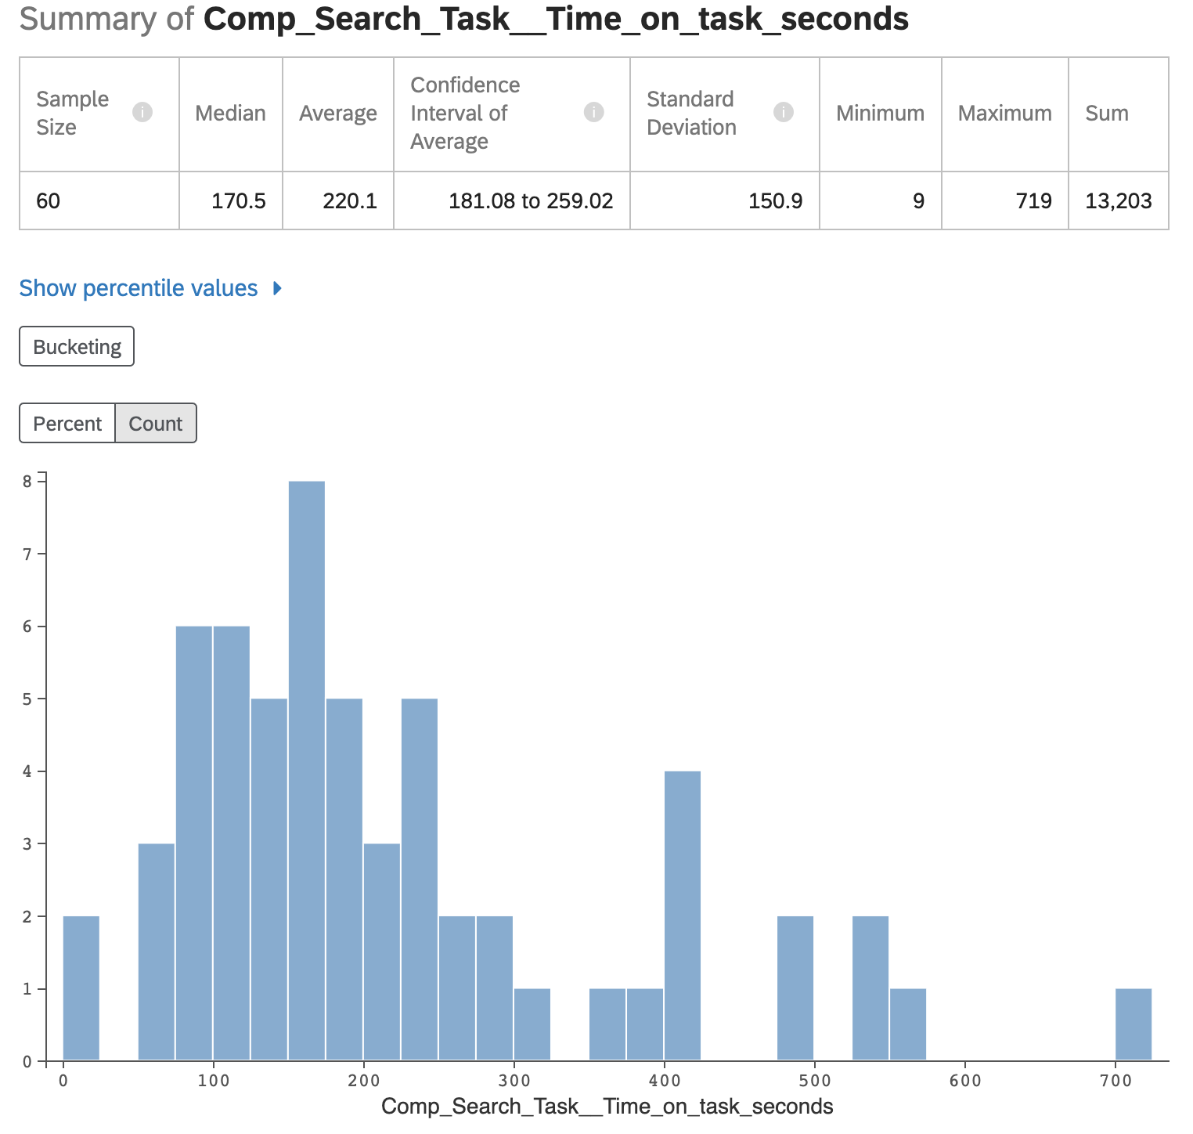
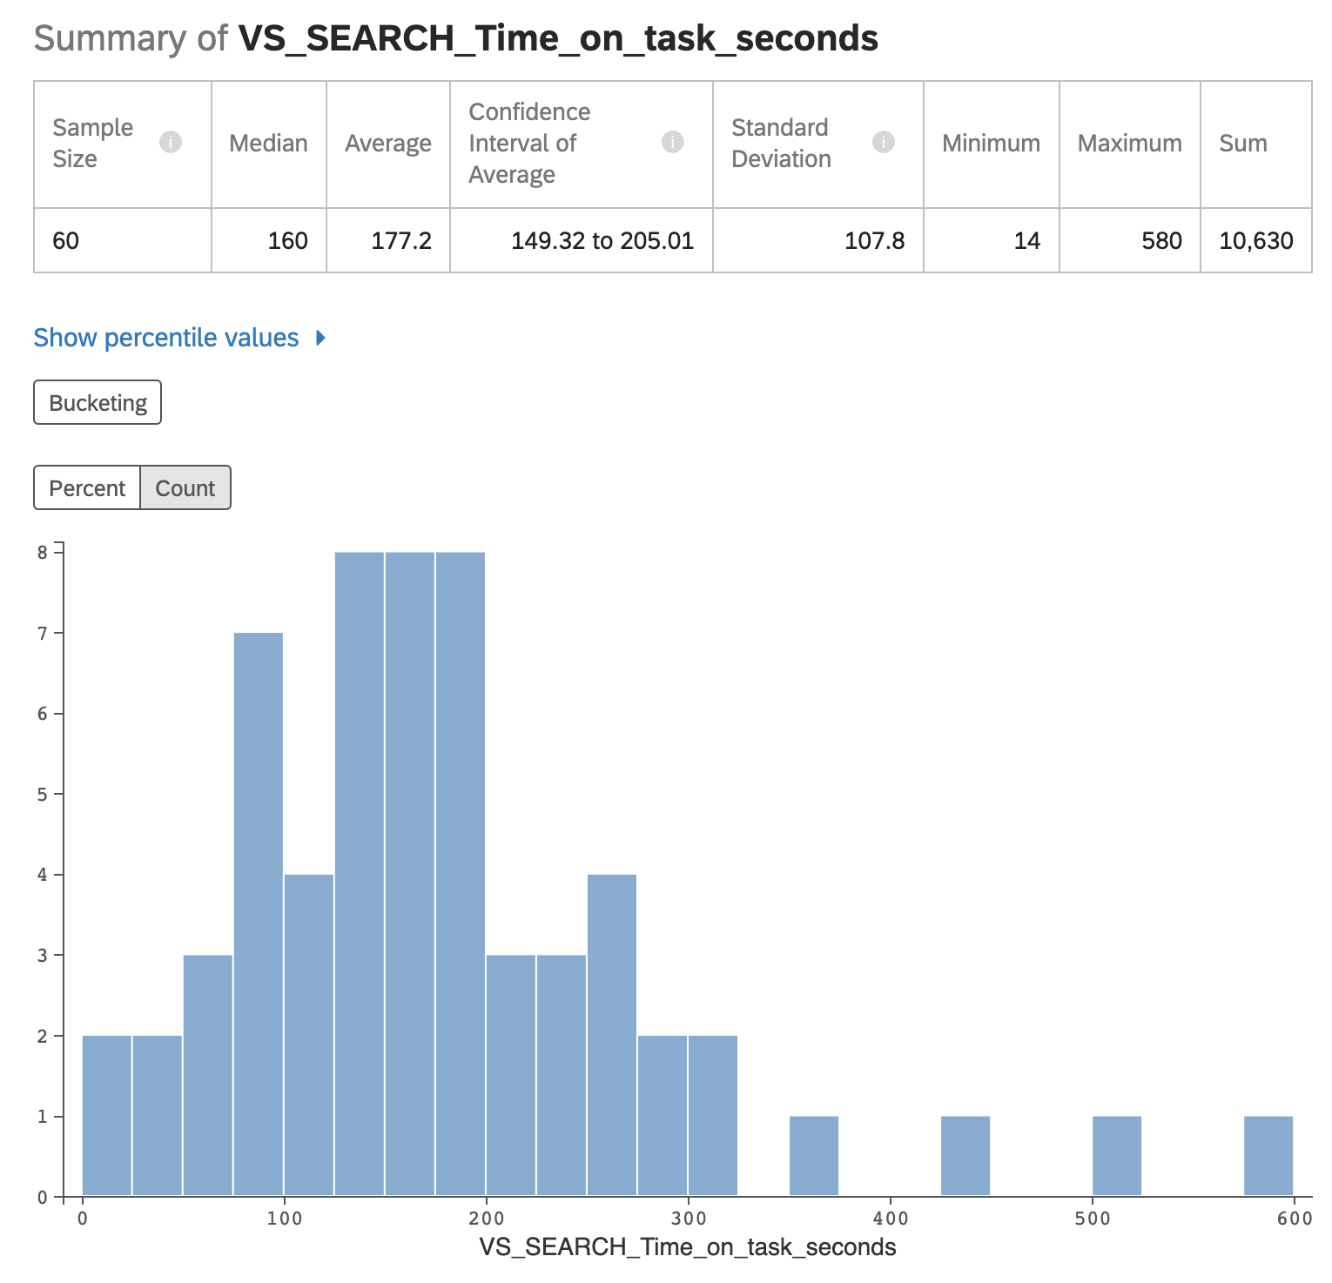
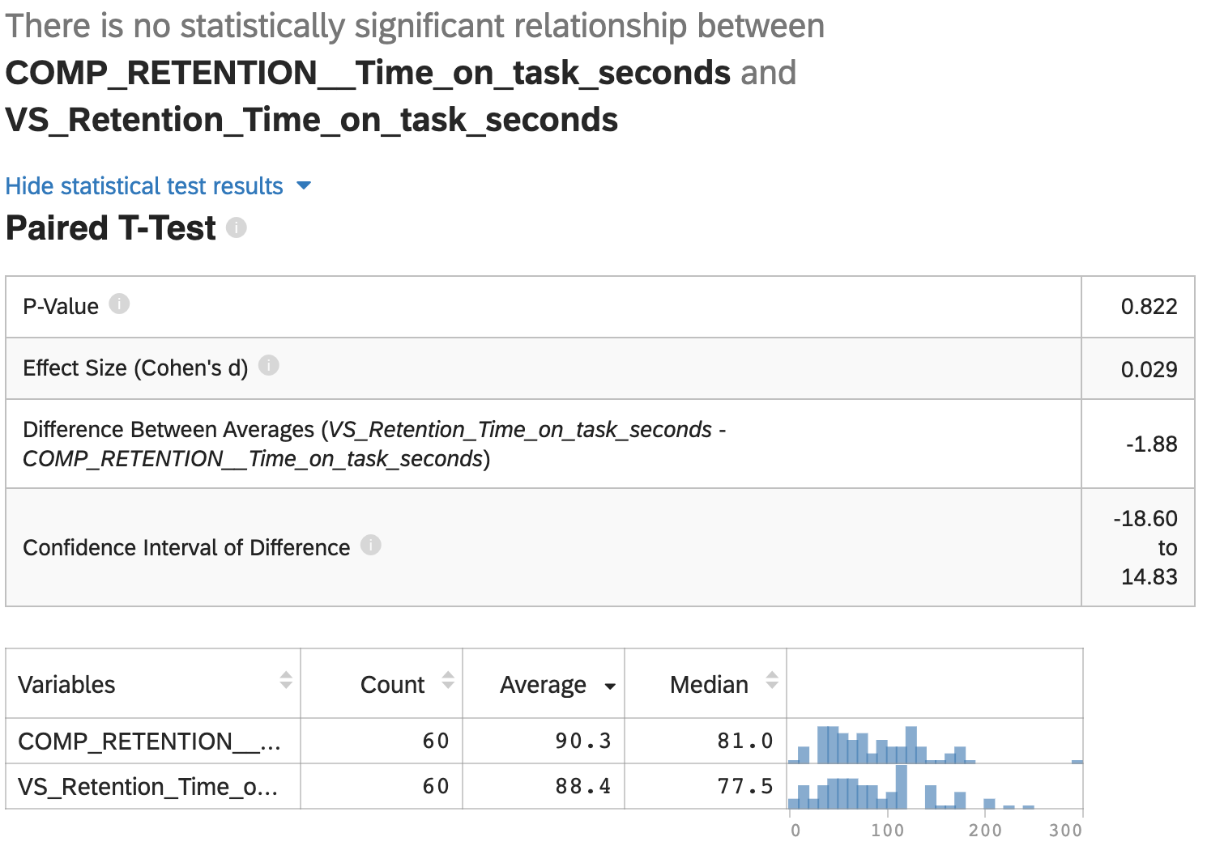
Users may spend just as much time on their search tasks on VS as they do on competitor sites.
HAPPINESS
ENGAGEMENT
ADOPTION
RETENTION
TASK SUCCESS
There was no statistical difference between VS search and Competitor search time. However, a larger study may show a difference. The average difference for this sample between competitors and VS was 43 seconds.
I.e. -participants searched longer on competitor sites (avg. 220 seconds), than on VS (avg 177 seconds).
Notes:
Why this matters: Retention and Checkout Conversions
See appendix:
Imagine this scenario:
*Today is the day!! I'm going to buy a ticket! I got a huge promotion, so I have no financial restrictions. I can go wherever I want, and whenever I want. I just need to decide on the event."
Based on this scenario, choose the site you would enter into the search bar or search engine.

Slide 5
Retention for Vivid Seats may be more difficult than for competitors.
HAPPINESS
ENGAGEMENT
ADOPTION
RETENTION
TASK SUCCESS
On average, Vivid was preferred to return to less frequently than competitors (45%/55% respectively, n= 60, p < 0.4) however, there is only a 60% chance this will be observed at the population level.*
Preference was tested against 74 variables, only two variables were associated: identifying as female, and SEQ.
Preference for Vivid Seats was associated with those who identify as Female (p < 0.05).
Self-reported ease of use ratings were positively correlated at the (p < 0.001 level).
No other variables were associated with preference including prior familiarity.
Preference was measured after a retention-based scenario and inventory/SES agnostic priming; i.e. after the entire test participants were asked who they would like to go back to at a later time if they had no economic constraints.
Therefore, these preference rates may be an important indicator for Retention KPIs.
Notes:
*in Social Science, significance that is less than 95% usually doesn’t get published or mentioned. However, it is rare in UX Research to not report overall preference rates, especially if it’s measured via retention. With a larger sample we could increase this confidence interval, since there were only 10 participant in each competitive test.
Why this matters: Retention and Checkout Conversions
See appendix:
Imagine this scenario:
*Today is the day!! I'm going to buy a ticket! I got a huge promotion, so I have no financial restrictions. I can go wherever I want, and whenever I want. I just need to decide on the event."
Based on this scenario, choose the site you would enter into the search bar or search engine.

Slide 6
Participants wanted to know about price and decide on price, even before they arrived at the homepage.
HAPPINESS
ENGAGEMENT
ADOPTION
RETENTION
TASK SUCCESS
Price was the most common term that participants used in order described what they needed to:
know you've learned enough from your search? [Top Graph]
decide to buy the ticket(s)? [Bottom Graph]
In both the know and the do question participants reported price almost twice as much as mentioning location.
Users did not expect to use price information for navigational reasons. They wanted to know and decide on this for contextualization and transactional reasons. This has important implications for understanding the intent of adoption.
Notes:
Adoption starts with understanding user’s context before they see the homepage.
TM-D & SG-D had the highest “price” terms. Keep in mind that this was before the participants even knew that they were going to be tested on TM and SG homepages.
Therefore, loose persona effects can be inferred: having made a ticket purchase in the last six months reliably captures Transactional personas for the test.

Slide 7
On average, 30% of VS homepage search query opportunities were not adopted. Keep in mind, all participants were specifically instructed to use the “search box.” So for some test segments to observe 60% adoption is qualitatively significant. Those participants who were in the Ticketmaster mobile group had the highest VS adoption rate. 40% of Seat Geek Desktop and Mobile participants did not VS homepage search query opportunities. Instead participants scrolled to other areas on the page, and or clicked on content in the page or in the drawer/menu.
HAPPINESS
ENGAGEMENT
ADOPTION
RETENTION
TASK SUCCESS
Average | 7.17
St.Deviation | 1.17
Notes:
Adoption definition: (providing input and leaving the homepage.)
Adoption starts with understanding user’s context before they see the homepage.
TM-D & SG-D had the highest “price” terms. Keep in mind that this was before the participants even knew that they were going to be tested on TM and SG homepages.
Therefore, loose persona effects can be inferred: having made a ticket purchase in the last six months reliably captures Transactional personas for the test.

Slide 8
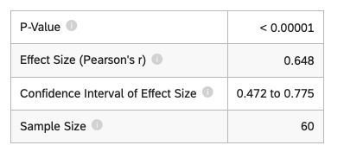
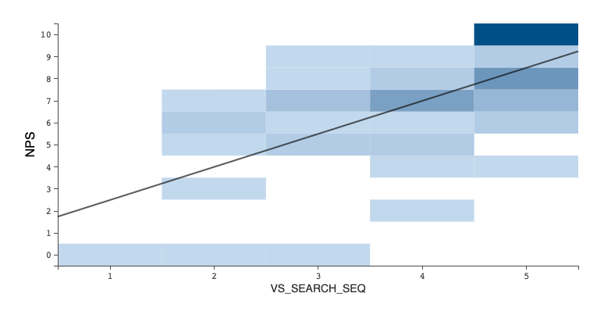
The average Vivid Seats NPS score was -5, and is strongly positively correlated with SEQ.
HAPPINESS
ENGAGEMENT
ADOPTION
RETENTION
TASK SUCCESS
Vivid Seats had the most promoters with Stubhub Desktop, and Ticketmaster Mobile.
Vivid Seats’ highest NPS was 20, after being tested against Stubhub Desktop and Ticketmaster Mobile.
The standard ease of use score (SEQ) was had the strongest correlation to NPS (“Large” Effect size 0.648, p < 0.00001)
This indicates that machine learning sentiment is reliably associated with user’s own self-reported ease of use.
Vivid Seats NPS Score - After Search Testing with Competitor and Vivid
Net Promoter Score (NPS)
This measures the likelihood of users to recommend your product or services. Scores range from -100 to 100 and include all participants.
 | DESKTOP |  |  |  | MOBILE
Competitor Priming | Ticketmaster | Stubhub | SeatGeek |  | Ticketmaster | Stubhub | SeatGeek
NPS Score | -30 | 20 | 10 |  | 20 | 0 | -50
%Detractors | 50 | 20 | 20 |  | 20 | 30 | 60
%Passives | 30 | 40 | 50 |  | 40 | 40 | 30
%Promoters | 20 | 40 | 30 |  | 40 | 30 | 10
Notes:
0.5 for Pearson’s r = Large effect size
There’s a 99.9999% we’re going to see this association at the population level.
Ticketmaster – more logos – non compete imagery – comp advantage

Slide 9
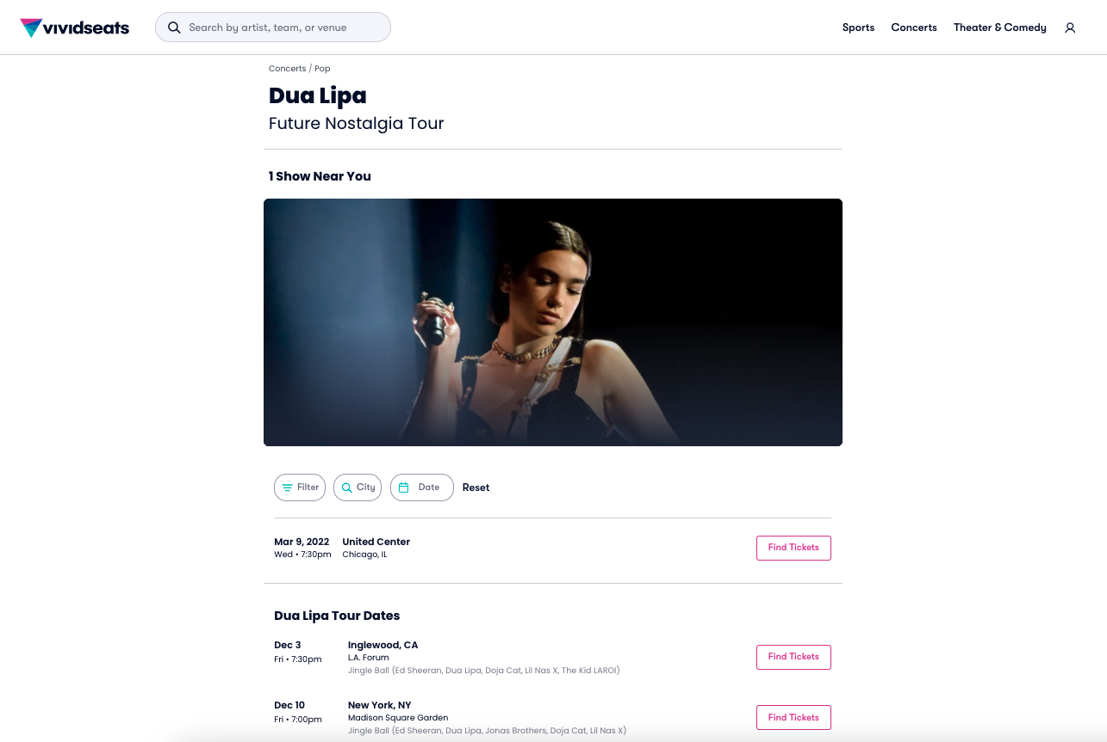
#3 – Cont’d Make pricing signifiers earlier and stronger
HIGH
$ 68 - 109
$$
Price
$ 68 - 109
$ 98 - 105
$ 345 - 400
X
There is no price signifier or filter on this page.
Users must click into each “find tickets” button to see the price range.
Has a pricing minimum and max range, just like the production page.
Note that competitors don’t do this on every page. So this could be strategic differentiation.
Notes:
What frustrated you most about the Vivid Seats site?
The prices for events weren't listed on the search results.
I had to select an event and go to the new page to see prices.
No ability to sort events by price It seemed a little more difficult to search for specific events.
It was hard to see pricing for specific events (had to click in it) I couldn't see the prices in the search page

Slide 10
#4 – Price Affordances are misleading
HIGH
Price signifiers act as false positives for navigation, causing significant re-work.
Users expect prices to be per unit available. Match between the real-world and the system.
Also, Jacobs law tells us that users spend most of their time on other sites. This means that users prefer your site to work the same way as all the other sites they already know.
This can have serious effects on brand perception.
Starting from $ 178/per 2 ticket minimum ($89/each)
$114/per ticket
Starting from $ 188/per 2 ticket minimum ($94/each)
RECOMMENDATION
X
Make price minimums from the perspective of the user, if it is not possible to spend $89 only then do not use the word “from.”
Here user is about to make the same mistake; $89 ends up being $178, because the unit starts at 2.
Uses the price that it is possible to start from.
Consider showing the unit minimum that is available.
Never user the word “from” if it’s not possible to start there, because that’s not where users will be going “from.”
Always show users where the bottom of the per unit pricing starts.
Notes:
By leveraging existing mental models, we can create superior user experiences in which the users can focus on their tasks rather than on learning new models.

Slide 11
UXR Assimilation Concepts
Test Plan Overviews and Tasks

Slide 12
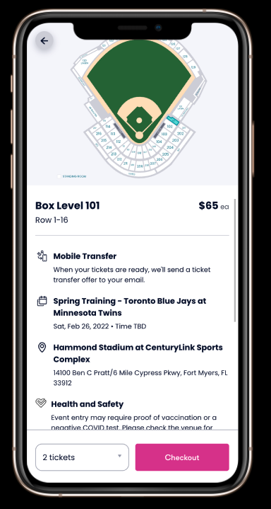
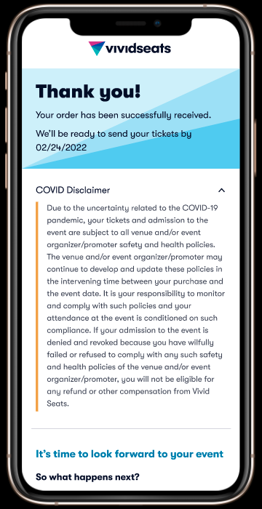
SUBJECTIVE
OBJECTIVE
TEST PLAN - OVERVIEW
INCOME SEGMENTS
Sports Interested OR
Loose Sports Interest
Scenario & Task
TASK
Measurements
Page Description - verbal
Retention
Info want to store
Blinded Price Comprehension-
Price key words
Price sentiment self rating
Price Comprehension
Price sentiment self rating
Blinded Order Handling Comprehension
Sentiment about When
Sentiment about Where
Confirmed vs Received Comprehension
Thank you page key words (meaning)
Trust
Increase or decrease
Reason
Page End - analytic
Retention
Mechanism
Blinded Price Comprehension-
Price Spending
Price Comprehension
Price breakdown, detail level
Blinded Order handling Comprehension
Accuracy about When
Accuracy about Where
Confirmed vs Received Comprehension
Fails (confirmed vs received)
Date comprehension
Match after detail priming to Q3 – Page Description Verbal
> $40K
$40-80K
$80K- $150K+
Notes:
Test plans are subsets of research plans and can only be designed after the basic stimuli is designed.

Slide 13
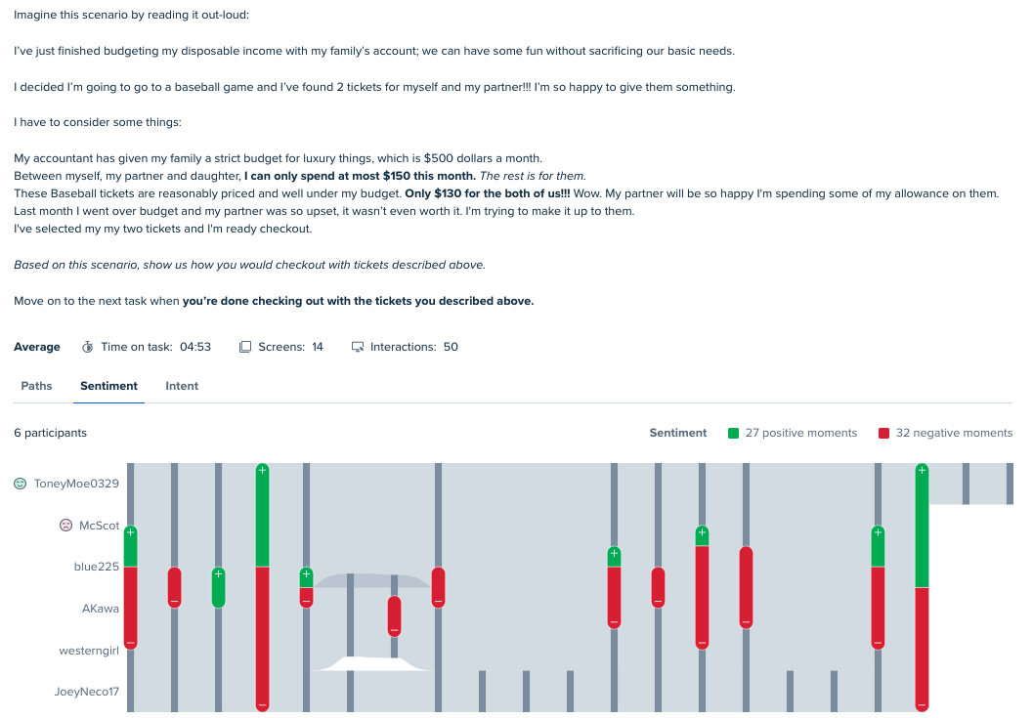
ESSENTIAL TASK ELEMENTS
First person “I”
Scenario:
User context (what where they just doing?)
Intent/Motivation
Game mechanics- A.K.A - Real World Constraints
Multi-player dynamics (family/friends)
Task Goal (stopping point, how the user thinks their successful)
“SHOW”
When to “move on”
Rorschach test - All of these things must be presented together to allow the user to show us what they will really focus on.
Notes:
Life is messy and not written down for you. So in some ways this is much easier than the real world. You don’t understand the game mechanics of your own life. Here they are neatly written down and can be used almost as a checklist.
Concsider that more market research on where the use is in the context of their life (before they arrive to our site) can make scenario scripting less detailed. However, then we must recruit exactly those samples which can delay testing needs.

