Slide 1
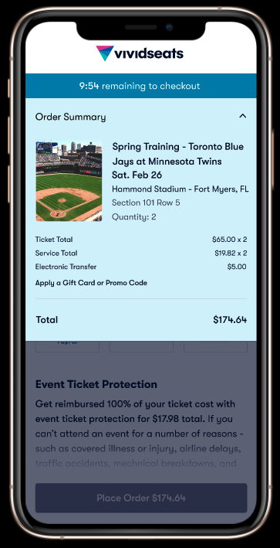
Checkout 2.0 - M1
How do we decrease cart abandonment and increase order-handling comprehension?
UX Research | Unmoderated Usability Study - Formative 1.0 – JIRA Ticket: UER-2
Senior UX Researcher, Dawn Procopio
UX Design Initiative for Q4 – Originally Presented on October 18, 2021

Slide 2
EXECUTIVE SUMMARY
KEY FINDINGS
76% of participants felt their checkout was successful, however, the average NPS score was 17.
Positive price expectations, comfort and understanding had the strongest relationship to NPS.
Objectively, 43% of participants failed (cart abandonment).
30% Struggled
27% Succeeded
Income had the strongest relationship with Objective Fails, Struggles and Success (p < 0.00001, Effect size: Very Large = 0.9; Large threshold is > 0.5)
GOAL
Increase conversions by reducing the number of checkout abandonments and remove any extra steps or distractions that could block an order. The goal of this research is to inspire, explore and choose new directions for design and product strategy, in order to reduce risk and improve usability of the experience, with an emphasis on conversions and operational efficiencies.
METHOD
Unmoderated Usability Test, Between Subject-Design
3 Key Segments: 2 cut points for income (40K, 80K; range > $19K - $150K); each 50/50 split between 2 levels of sports interest (measuring changes between low income and high income users, also changes between event interest levels (for this study it was sports
Device: Mobile Responsive Web only
All participants (n = 30) were asked about various search motivations and goals, and prompted with the same 2 scenarios tasks, starting from the homepage of either Vivid Seats or one other competitor. Information salience was tested via confidence self-report and then a memory test proposition. At the end, retention was measured with a preference question.
KEY HYPOTHESES
STRATEGY
EXECUTION
ASSESSMENT
SUPPORTED | Income will be statistically associated with checkout success.
NEEDS RESEARCH | Cart abandonment will be statistically associated with personas with less event interest.
NEEDS RESEARCH | Almost all participants will not conflate order confirmations with order received.
NOT SUPPORTED | Most participants will understand order handling, know when their ticket will be sent by and where they should look for it.
Notes:
STRATEGIZE: In the beginning phase of the product development, you typically consider new ideas and opportunities for the future. Research methods in this phase can vary greatly.
EXECUTE: Eventually, you will reach a "go/no-go" decision point, when you transition into a period when you are continually improving the design direction that you have chosen. Research in this phase is mainly formative and helps you reduce the risk of execution.
ASSESS: At some point, the product or service will be available for use by enough users so that you can begin measuring how well you are doing. This is typically summative in nature, and might be done against the product’s own historical data or against its competitors.

Slide 3
RECOMMENDATIONS
HIGH
Order Summary
To enhance transparency and clarity, always explain custom terms like “service total.” Ex. Instead of the term “service total” all fees could be listed.
To enhance freedom and control, consider breaking this price out and/or using a tool tip to show more information about alternatives. Ex. Include Klarna where the line is for applying a gift card or coupon, in addition to keeping it here.
Place order page
Use progressive disclosure in order to prevent errors. Don’t allow users to skip ahead, otherwise extensive error/empty field validation and auto scrolling will have to be programed.
Force engagement with accordion panels, or gated anchors, which prevent users from even seeing the next set of interactions within the page. Auto-open each panel when the required interactions are validated.
Final Page
To increase recognition over recall offer users a reminder or something clickable related to the date (see right; ex. +Add to calendar).
To increase clarity differentiate the important information item (ex. Date) with a different color. Consider using the word form of the date since speech based information may help recall.
MEDIUM
T&A Header
To enhance Consistency and Standards audit the experience for words that are in conflict with subsequent pages.
Talk to legal about what other word we can use hits paragraph, besides confirm.
Consider re-labeling the T&A header with “Agree & Place Order”
LOW
Login:
Let users know they are still in the checkout process, and remind them of what they were just doing. Plan for users who go to do other things while at this step and then later return to this screen (they will need some hints).
Consider contextualizing the main CTA to “Continue Checkout.”

Slide 4
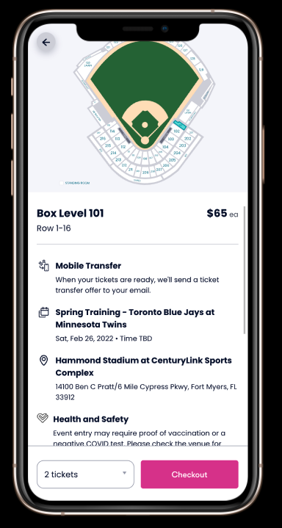
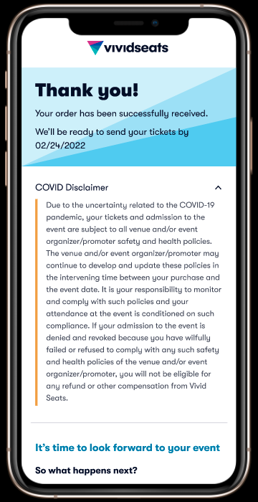
SUBJECTIVE
OBJECTIVE
TEST PLAN
INCOME SEGMENTS
Sports Interested OR
Loose Sports Interest
Motivation and Needs Scenario
TASK
Measurements
Page Description
Retention
Info want to store
Blinded Price Comprehension-
Price key words
Price sentiment self rating
Price Comprehension
Price sentiment self rating
Blinded Order Handling Comprehension
Sentiment about When
Sentiment about Where
Confirmed vs Received Comprehension
Thank you page key words (meaning)
Trust
Increase or decrease
Reason
Page End
Retention
Mechanism
Blinded Price Comprehension-
Price Spending
Price Comprehension
Price breakdown, detail level
Blinded Order handling Comprehension
Accuracy about When
Accuracy about Where
Confirmed vs Received Comprehension
Fails (confirmed vs received)
Date comprehension
Match after detail priming to Q3
> $40K
$40-80K
$80K- $150K+
Notes:
Prototype: https://www.figma.com/proto/205ik8fkdUxfIMfahSID6L/B2C-Checkout?page-id=7%3A258&node-id=754%3A8340&viewport=275%2C48%2C0.47&scaling=scale-down&starting-point-node-id=651%3A5908&show-proto-sidebar=1

Slide 5
DEMOGRAPHICS
Age average - 36
Slightly more participants identified as male 56%; statistically half & half
Income was strictly controlled, per our test plan hypotheses
Most participants 40% were employed full-time; very few were unemployed
Most participants were Advanced 63.3%.

Slide 6
What happened in the checkout?
HAPPINESS
ENGAGEMENT
ADOPTION
RETENTION
TASK SUCCESS
This section answers research questions that deal with the “what” ”how many”/ “how much” using Google’s HEART framework for UX.
In another section we’ll answer “why?”
Notes:
So this section is much shorter than previous because research that is executive-strategic has twice as many qualitative objectives as an executive-assessment.

Slide 7
76% of Participants felt successful
HAPPINESS
ENGAGEMENT
ADOPTION
RETENTION
TASK SUCCESS
There’s a 95% chance that 59-88% of the population will feel successful in this checkout flow; at most with this confidence level, 41% will feel not successful. This did not statistically differ by income or by sports interest. The difference for self-reported success is shown below.
Tested against 60 other variables in the test, SEQ (the participant’s standard ease of use rating) had the highest effect and confidence level (p < 0.001 level, Very Large Effect Size, Cohen’s D 2.79) . This indicates that if participant’s felt successful if they felt like it was easy.
Only two other variables had a statistically significant relationship: Gender and Blinded Price Comfort Rating which we’ll review on the next few slides. Gender is discussed in the appendix – an ongoing tracking for all research is being collected. Past research also aligns with less than optimal results for those identifying as male.
Notes:
But this is weird…

Slide 8
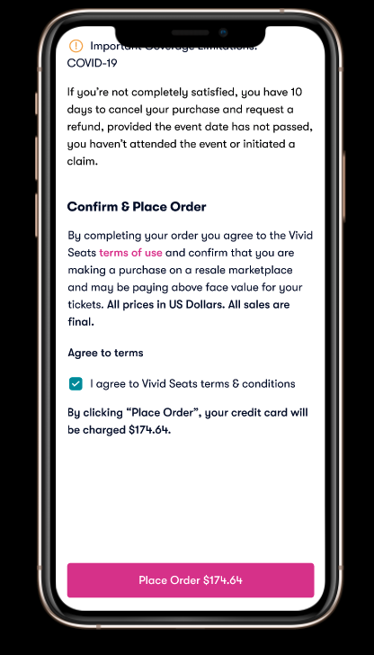
TASK SUCCESS
How many checkouts actually succeeded?
27% Succeeded
30% Struggled
43% Failed
However, this story is not true for everyone. Participants in low to medium income households observed a 20% MORE fails than those in high income households.
In this section we’ll address the differences in this outcome, but in the next section we’ll cover why this also presents different usability issues.
Notes:
Objective Success - Meaning, they reached the checkout page without ending the task, indicating any abandonment, or potential validation errors. (No automatic metric or question can measure this without direct observation).
Normally, we (UXRs) don’t watch all the videos (in Execution phases) – but for Strategy phases, the quantitative significance is inherent. So all 30 videos were analyzed and coded in order to get these numbers.

Slide 9
HAPPINESS
ENGAGEMENT
ADOPTION
RETENTION
TASK SUCCESS
Objective Task Success is strongly related to income.
The low income segment had a 10% success rate.
The medium income segment ($40K – $80K) had a 20% success rate
The high income segment ( > $80K+) observed a 50% success rate
Notice that even in an interocular test, shows a correlation between movements towards success and higher income.
Notes:
This is quite impressive from a testing standpoint. It means that the task reflected real world constraints.

Slide 10
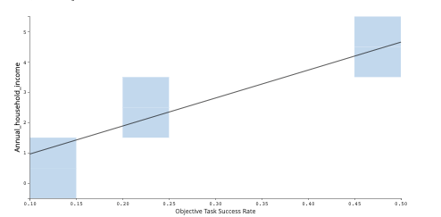
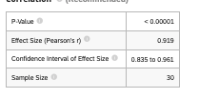
HAPPINESS
ENGAGEMENT
ADOPTION
RETE NTION
TASK SUCCESS
Objective Task Success is strongly correlated to income (p < 0.00001)
Not only is annual household income very likely to to impact users in the real world, but it also accounts for a very large effect (> 0.9; threshold is > 0.5).

Slide 11
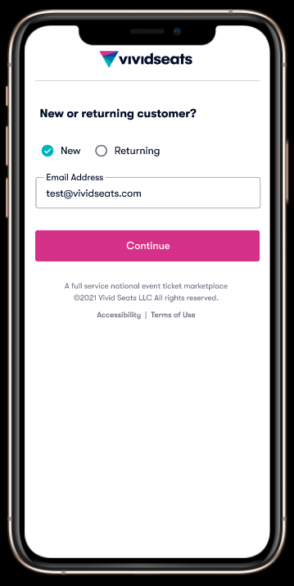
ADOPTION
87% adopted the first step in the checkout process.
13% of participants directly observed expressed hesitation or confusion. Of those, all were in the medium to low-income segment (50/50 split).
The next section shows the root cause analysis about why this might be the case for some participants.
Notes:
Entering your email was adoption interaction – keep in mind that the previous screen is the one that sets the stage. The observations here could be higher or lower due to test artifacts.
Falling in line with social science literature on stress and less income, we should keep in mind that having less money can make you question
-
Participants were previously told on the first step of the test: “Please note: This test involves a prototype. At no point will you be asked to use your own personal information. The pages will automatically enter in information for any text field inputs.”

Slide 12
ENGAGMENT
43% of participants abandoned the order summary page.
However, this didn’t always lead to failing to checkout. Most indicated that they would “cancel” or not purchase the tickets in that moment because that’s not why they hit checkout in the first place.
Some participants looked for a way back to double check what they saw. A few wanted to go back to choose a different ticket.
56% decided to come back or stay, and consequently sacrifice their original intentions.
Notes:
Entering your email was adoption interaction – keep in mind that the previous screen is the one that sets the stage.

Slide 13
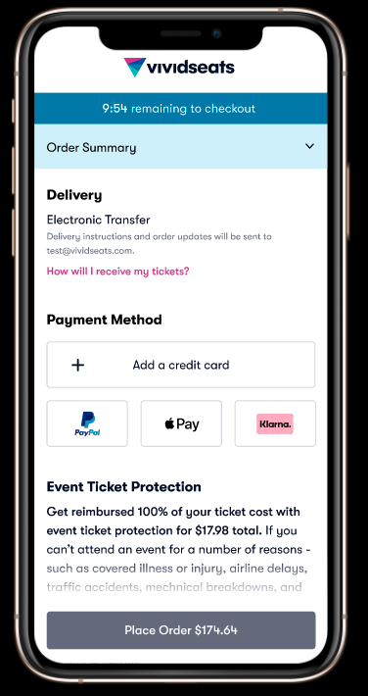
ENGAGMENT
6% of participants recognized that they could use Klarna to meet their price expectations and successfully checkout.
After realizing that the price was higher than the task scenario allowance the some users closed the drawer in hopes that they could find a way to lower the price.
When they tapped on Klarna they verbalized their price lowering expectation with Klarna.
This just happened to be only people in the high income segment.
This was also the only way to satisfy the task scenario. Future research may consider engagement with Klarna as the only true definition of task success.
Notes:
Entering your email was adoption interaction – keep in mind that the previous screen is the one that sets the stage.

Slide 14
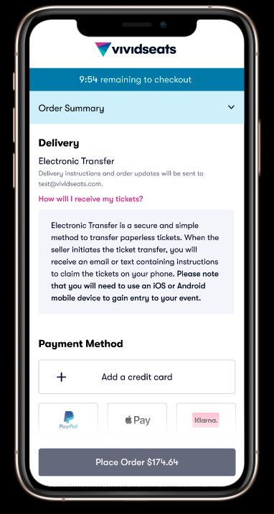
ENGAGMENT
26% of participants clicked on the electronic transfer pink question: How will I receive my tickets?
Most participants clicked here to search for more ways to reduce their total ticket price- not to get more information about electronic transfer.
57% of eligible participants did not click this information.
This was split almost evenly between all income segments.
Notes:
*eligibility means they saw this screen and didn’t abandon before seeing this.
Maybe this doesn’t matter right here. We’ll talk about this later in the how and why section.

Slide 15
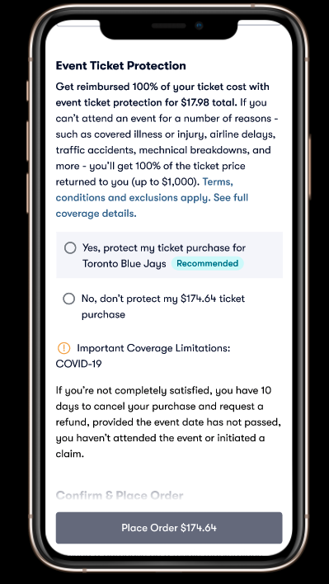
ENGAGMENT
40% of participants skipped the credit card input and initially and scrolled back and forth.
Most of these participants stopped at the insurance options and attempted to click, or they attempted to click the T&A Agreement.
This type of engagement led to significant checkout struggling. Participants scrolled up and down to scan information to determine a few different things.
In one instance, a participant gave up after not being able to figure out what was missing and then claimed that they were giving up because of the price.
On face this seems like a test artifact (prototype issue) however, it’s much more than that. In the next section we’ll discuss how and why this could be a huge input validation problem.
Notes:
In this sense skipping around is sad path and not just a test artifact.

Slide 16
ENGAGMENT
83% of participants did not sufficiently engage with the dates on the last page.
Participants were asked to select when they would get their tickets based on a multiple choice with false dates.
Only 17% said that none of these appl (which was the correct answer.)
This was all while being able to view the final page of the prototype (pictured right.)
The next section deals with why this could be the case.
Notes:
In this sense skipping around is sad path and not just a test artifact.

Slide 17
ENGAGMENT
36% of participants described this as a confirmation page.
Participants were asked to describe this page in one sentence. They were presented with this page, in order to look back and scan it as much as they would like.
33% used the word summary.
The next section deals with why this could be the case.
Notes:
In this sense skipping around is sad path and not just a test artifact.

Slide 18
Memorability of the total cost may aid retention.
ADOPTION
RETENTION
HAPPINESS
ENGAGEMENT
RETENTION
TASK SUCCESS
An astounding number (93%) of participants remembered what the total cost of the tickets were- without looking at the page and after 4 other questions.
Even if they indicated that they would not continue checking out because the price was over budget or never actually checked out.
Why is this good?
Recall, from previous research (Search Competitive Analysis) that remembering a price was correlated with preferring to come back at a later time. Hence, retention may be benefit when the total cost is easily remembered.
Think about how this works: if users are dissatisfied with the price now, but also able to remember it, their comparison on competitor sites may benefit Vivid Seats.
We’ll talk about how and why this price memorability happens in the next section.
Notes:
This may be why 76% of participants thought they were successful.

Slide 19
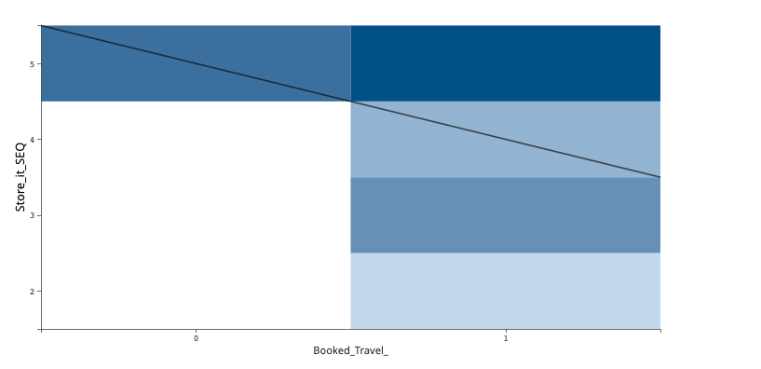
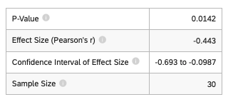
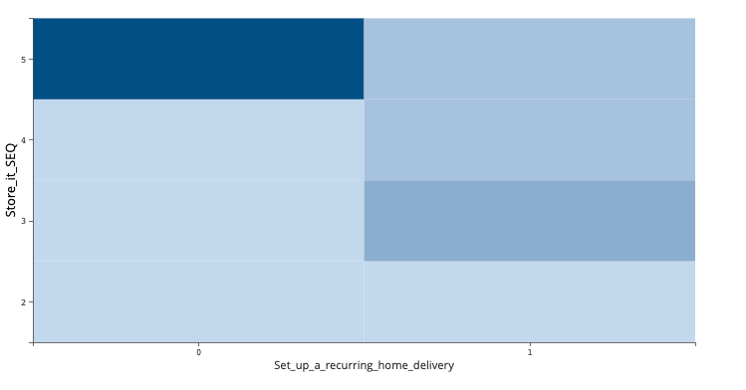
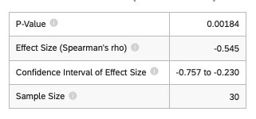
HAPPINESS
ENGAGEMENT
ADOPTION
RETENTION
TASK SUCCESS
Storing information SEQ to come back to was negatively correlated with other booking travel and setting up reoccurring home deliveries.
Participants were asked:
Show us what, if any, information you would like to come back to and how you would store it.
Move on to the next task when you feel you could return to this information at a later date.
Then participants rated the ease of use of doing this task (1-5, SEQ, were 5 means very easy). On average users felt like it was somewhat easy to come back to the information they wanted to (4.3/5)
However, participants who had booked travel or set up reoccurring deliveries were more likely to not think this was easy.
This may indicate that other ecommerce activities make it more clear on what and where they can go back to for information.

Slide 20
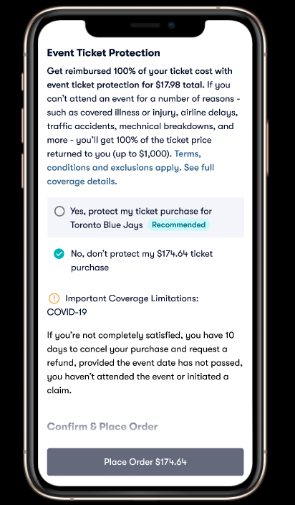
HAPPINESS
43% of participants could reasonably said to be still happy.
c
Machine analyzed sentiment and NPS were both clearly low.*
Of all the machine analyzed sentiments only 38% were positive. This aligns slightly with participant’s average NPS score 17 (43% Promoters, 30% Passives, 27% Detractors).
For High Income participants 45% of sentiments were positive. (NPS 20)
For Medium Income participants 60% of sentiments were positive. (NPS 10)
For low income participants 11% of sentiments were positive. (NPS 20)
Notes:
For this study we’ll mostly rely on NPS score as an indicator of happiness – specifically those who are promoters.
Do you want to see a purely happy checkout path video?
KPOX:
https://app.usertesting.com/v/8631a852-d581-46e5-9179-1dccae63e946?encrypted_video_handle=8c58b598-d39f-48e5-ba28-efd8d15ac51c&note_id=annotation-12053491&start=267#!/notes
Participant featured: McScot
*Previous research (Search Comp Analysis) suggests that machine analyzed sentiment aligns with NPS averages.

Slide 21
HAPPINESS
ENGAGEMENT
ADOPTION
RETENTION
TASK SUCCESS
Vivid Seats NPS Score
SES Segments Vivid
Net Promoter Score (NPS)
This measures the likelihood of users to recommend your product or services. Scores range from -100 to 100 and include all participants.
 | Mobile Responsive Web
Test Segment | High Income | Medium Income | Low Income
NPS Score | 20 | 10 | 20
%Detractors | 30 | 30 | 20
%Passives | 20 | 30 | 40
%Promoters | 50 | 40 | 40
NPS was not related to any canon demographic or brand awareness background.
It was related to these 5 things that we’ll discuss on the next slides:
Being comfortable with the price they had remembered (before revisiting)
Understanding the price before revisiting it
Agreeing that the price met their expectations after they revisited
Booking travel
And holding a false belief that their tickets were begin delivered.
 | Average | St.Deviation
NPS | 17 | 6
DETRACTORS | 27 | 6
PASSIVES | 30 | 10
PROMOTERS | 43 | 6
Notes:
Travel can have heteroskedastic effects on income and vice versa- meaning that this may also be a function of very high income.

Slide 22
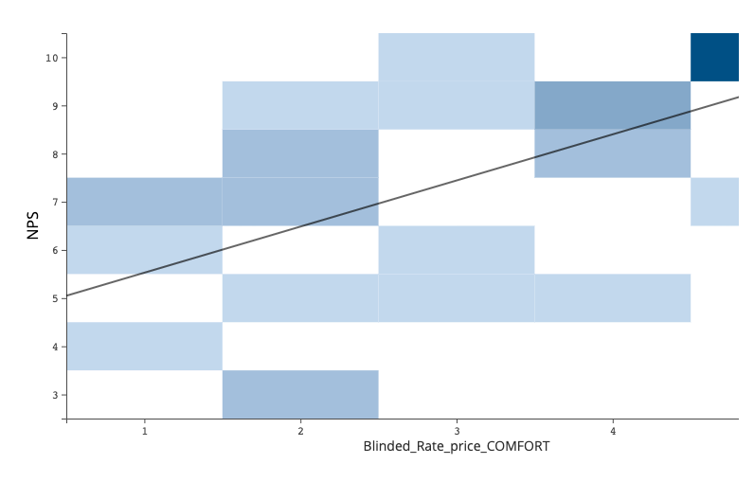
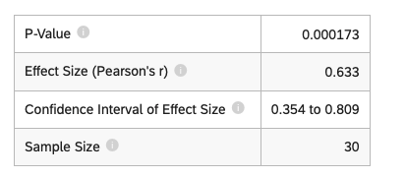
HAPPINESS
ADOPTION
RETENTION
TASK SUCCESS
HAPPINESS
ENGAGEMENT
NPS score was strongly positively correlated with being comfortable with price memorized (p < 0.001).

Slide 23
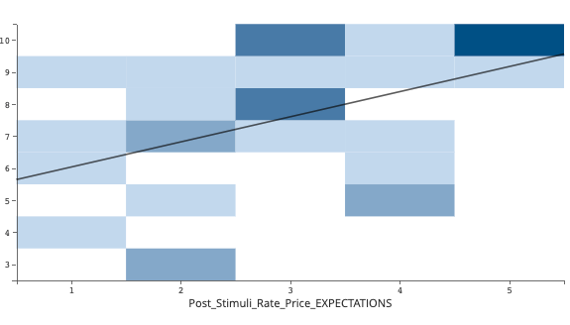
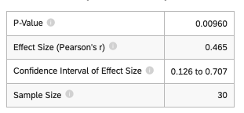
HAPPINESS
ADOPTION
RETENTION
TASK SUCCESS
HAPPINESS
ENGAGEMENT
NPS was also correlated price understanding (p < 0.05) and meeting expectations (p < 0.01).
So how does this happen?

Slide 24
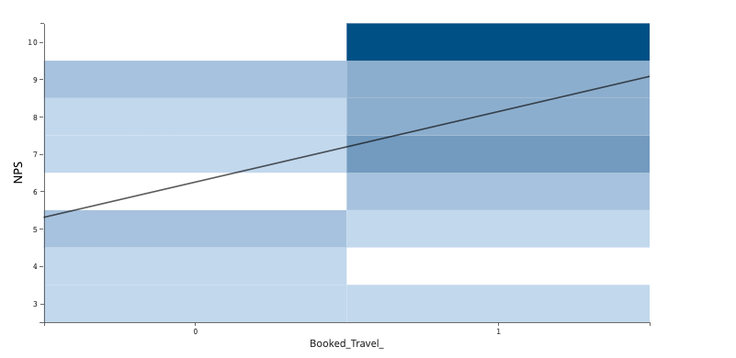
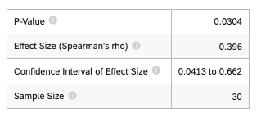
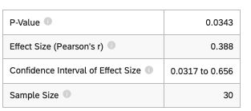
HAPPINESS
ADOPTION
RETENTION
TASK SUCCESS
HAPPINESS
ENGAGEMENT
Unlike the ease of use in retention tasks, NPS was correlated with booking travel ( p < 0.05) .
On average, booking travel has a moderate effect effect on participant’s NPS score. If they had booked travel they were more likely to have been a promoter.
Which means that if we want to study how and why booking travel sets better expectations we should see design references there.
More on this in the next section.

Slide 25
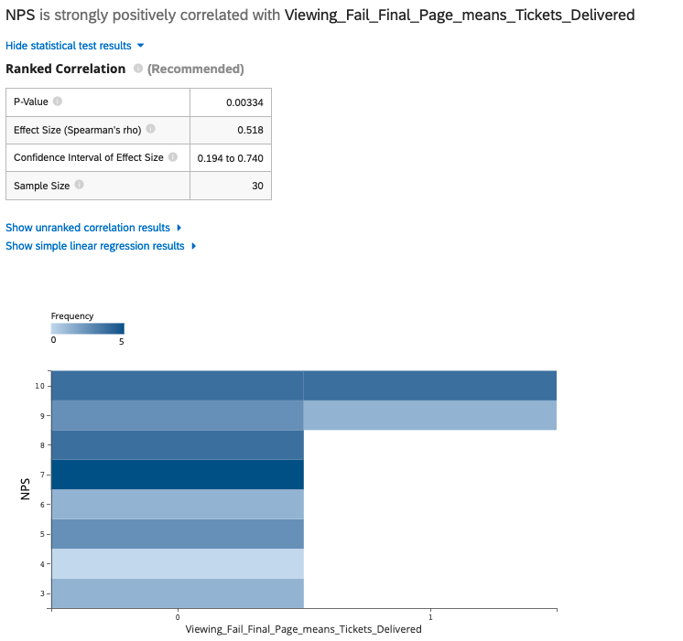
HAPPINESS
ADOPTION
RETENTION
TASK SUCCESS
HAPPINESS
ENGAGEMENT
But NPS was also correlated with false beliefs about the order confirmation page.
Some users checked-out thinking that the Tickets were already delivered.

Slide 26
Why and how did this happen?
HAPPINESS
ENGAGEMENT
ADOPTION
RETENTION
TASK SUCCESS
This section deals with qualitatively significant problems that were sampled amongst participants that observed at least one of the quantitative problems identified in the previous section.
Notes:
RQ 6. How do key competitors compare to Vivid?
Who did they prefer?
What are their self reported pain points?
Which competitor had more comprehension and information salience?
Which competitor had more self-reported success?
Which competitor had higher ease of use scores?

Slide 27
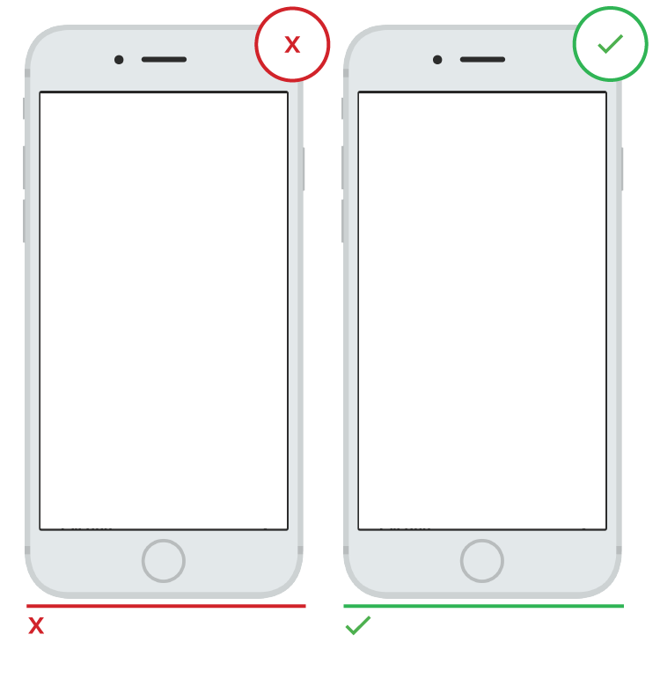
5 Email requirement needs explaining
ADOPTION
LOW
The question and email input lacks context; it requires that users recall vs recognize the purpose.
Only a few participants did not initially attempt to enter an email address. Instead, they hesitated or looked back at the task when they arrived on the login page. After some consideration, they eventually tapped the email field.
Continue to Checkout
RECOMMENDATION
Let users know they are still in the checkout process, and remind them of what they were just doing. Plan for users who go to do other things while at this step and then later return to this screen (they will need some hints).
Consider contextualizing the main CTA to “Continue Checkout.”
This lacks task context. User may infer that this is an accident, or they could put their phone down, return, and not know why they are seeing this screen.
This shows the previous user context, letting them know this is intentional and part of what they were doing previously.
Notes:
Re: 13% (87% Adopted)
Keep in mind this doesn’t ask users to login technically, nor does it carry forward any previous screen context.
Error Prevention and recovery
AgedSea3163
Amcoop05
afg0062
#loginunexpected #nobackbutton And I'll click on on your returning customers. Okay. Can I go back somehow? And I want to go back that page because as soon as I clicked okay, I'll try to uh, click
The question should be – where should we send your order? Not new or returning customer because at this step we’re not authenticating that they they are the owner of that email. So technically someone cold go through this whole checkout with someone elses email address. Also, what if someone enters an email address that has been used before, and they forgot?
Really this screen is about where to send the order in the first place.

Slide 28
Explain the additional prices and offer alternatives
TASK SUCCESS
HIGH
The service total lacks clarity and transparency but also makes Vivid Seats the sole owner of this mark up. Secondly, Klarna offers more control and freedom in this situation but lacks visibility in this moment (where users are most likely to abandon.)
The only users who were successful were the ones that later verbalized use of Klarna, or that they expected sales tax (these participants also happened to be in the medium to high income range.)
Low income participants for this event are considered sticker shock vulnerable - they need extra signifiers to understand what freedom and control they have over this situation.
Florida Sales tax 10% $6.50 x 2
Service Fee 20% $13.00 x 2
RECOMMENDATION
To enhance transparency and clarity, always explain custom terms like “service total.” Ex. Instead of the term “service total” all fees could be listed.
To enhance freedom and control, consider breaking this price out and/or using a tool tip to show more information about alternatives. Ex. Include Klarna where the line is for applying a gift card or coupon, in addition to keeping it here.
“Service total” is ambiguous.
Service fees explained.
Service total is ambiguous.
Notes:
#cartabandonment obviously will be about my budget. So I have to change the tickets again. For this i'll have to go back, which I don't think I'm able to do this
“
Afg0062
6% of participants recognized that they could use Klarna to meet their price expectations and successfully checkout.

Slide 29
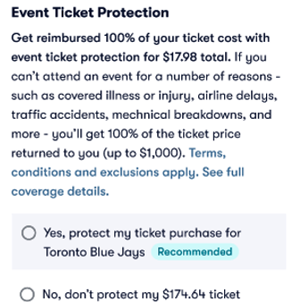
Checkouts struggle after skipping around
ENGAGMENT
HIGH
There is no real checkout funnel. Empty fields currently don’t have validation and are not auto-scrolled to- so users must scroll to find out what the problem is. Important information is initially missed or not even seen.
Promo Code Applied - $174.64
More information is available than necessary, creating a cognitive overload. Users must scan all the information on the page in order to see what the problem is, and what interactions they should do next. Participants in this study tapped several times on things only to eventually realize that there is information they haven’t filled out yet.
40% of participants skipped the credit card input and initially and scrolled back and forth.
Only 26% of participants engaged with the electronic transfer information.
2. Delivery – Electronic Transfer - How will I receive my tickets?
RECOMMENDATION
3. Add Card and Billing address
Use progressive disclosure in order to prevent errors. Don’t allow users to skip ahead, otherwise extensive error/empty field validation and auto scrolling will have to be programed.
Force engagement with accordion panels, or gated anchors, which prevent users from even seeing the next set of interactions within the page. Auto-open each panel when the required interactions are validated.
4. Agree To Terms and Conditions - Unchecked
No input is required initially; users can easily skip around
Funneling - users must interact with the panel/drawer that is open and cannot open other panel drawers until the input is validated. The next drawer/panel auto-opens for the user.
Notes:
Also 57% of eligible participants did not click the ET information.
Error Prevention and recovery
Amcoop05
afg0062
#skipsahead #usabilitycheckoutfailreason

Slide 30
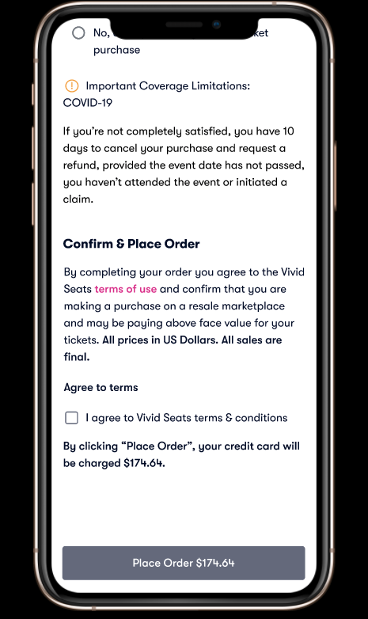
It’s not a confirmation, but it asks you to “confirm”
ENGAGMENT
MEDIUM
The word confirm is on the previous page. Users should not have to wonder whether different words, situations, or actions mean the same thing. Follow platform and industry conventions.
36% of participants described the next page as a confirmation page.
Users who had more positive sentiment about the overall process had previously booked travel.
Agree & Place Order
RECOMMENDATION
To enhance Consistency and Standards audit the experience for words that are in conflict with subsequent pages.
Talk to legal about what other word we can use hits paragraph, besides confirm.
Consider re-labeling “Confirm & Place Order” header with:
“Review & Place Order”
“Agree & Place Order”
“Reserve your Seat & Place Order”
The word “confirm” sets expectations for “confirmation.”
The word ”confirm is removed.
Notes:
Recommendation – general guideline – I’m am not a solution describer, I just describe the problems. However, sometimes it helps you see how I view the problem.

Slide 31
Force proactive engagement to decrease Support Calls.
ENGAGMENT
RETENTION
Order Received!
We’ll be ready to send your tickets by February 24th 2022 – Click the alarm to get reminders about your email or spam folder.
Download order placement or return to your account dashboard.
Share this event order with your friends in a text message or on your social media.
HIGH
There is a lot of text that competes for attention. The main pieces of information that inform the user’s next steps is crowded out, and requires users to recall vs. recognize what they should do next.
Almost all participants scrolled down on this page and even read the date out-loud (in words, not numbers). However, 83% of participants failed the ticket date comprehension question after the task. They had full access to this page.
30% of participants did not agree that they understood when their tickets would be getting their tickets. 20% did not understand where they would be getting the next piece of information.
RECOMMENDATION
To increase recognition over recall offer users a reminder or something click able related to the date (see right).
To increase clarity differentiate the important information item (ex. Date) with a different color. Consider using the word form of the date since speech based information may help recall.
The important information at the top and throughout the page are hard to remember, but also relatively hard to see compared to everything else.
Forcing engagement with a programmable iOS, Android reminder. Have the reminder explain that they should check their spam folder as well as email.
Notes:
Also - Recall:
Storing information SEQ to come back to was negatively correlated with other booking travel and setting up reoccurring home deliveries.
Unlike the ease of use in retention tasks, NPS was correlated with booking travel ( p < 0.05) .
Allow users to set a reminder to check their emails and spam folder by this date.
The ability to hold on to speech-based information in short-term memory is called phonological memory.

Slide 32
RECOMMENDATIONS
HIGH
Order Summary
To enhance transparency and clarity, always explain custom terms like “service total.” Ex. Instead of the term “service total” all fees could be listed.
To enhance freedom and control, consider breaking this price out and/or using a tool tip to show more information about alternatives. Ex. Include Klarna where the line is for applying a gift card or coupon, in addition to keeping it here.
Place order page
Use progressive disclosure in order to prevent errors. Don’t allow users to skip ahead, otherwise extensive error/empty field validation and auto scrolling will have to be programed.
Force engagement with accordion panels, or gated anchors, which prevent users from even seeing the next set of interactions within the page. Auto-open each panel when the required interactions are validated.
Final Page
To increase recognition over recall offer users a reminder or something clickable related to the date (see right; ex. +Add to calendar).
To increase clarity differentiate the important information item (ex. Date) with a different color. Consider using the word form of the date since speech based information may help recall.
MEDIUM
T&A Header
To enhance Consistency and Standards audit the experience for words that are in conflict with subsequent pages.
Talk to legal about what other word we can use hits paragraph, besides confirm.
Consider re-labeling the T&A header with “Agree & Place Order”
LOW
Login:
Let users know they are still in the checkout process, and remind them of what they were just doing. Plan for users who go to do other things while at this step and then later return to this screen (they will need some hints).
Consider contextualizing the main CTA to “Continue Checkout.”

Slide 33
Appendix
Study Limitations; Test Artifacts; Special Findings

Slide 34
Appendix - A
Test Artifacts

Slide 35
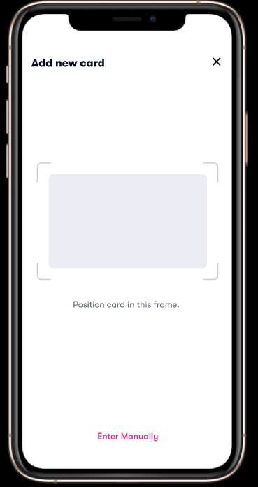

Slide 36
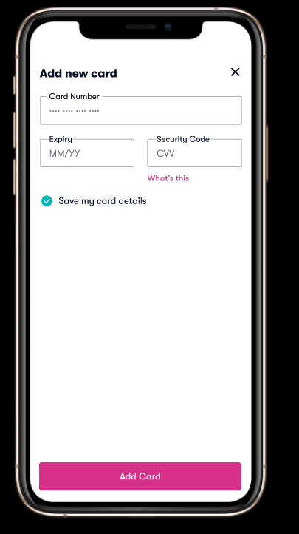
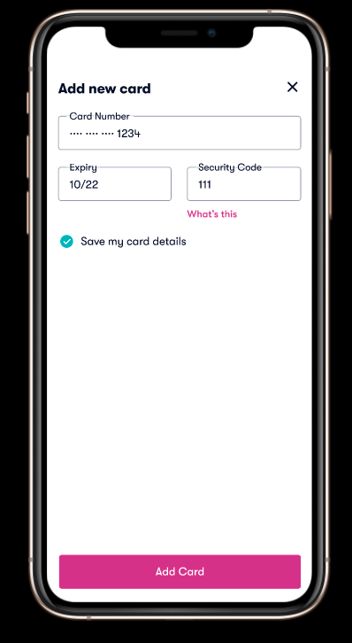
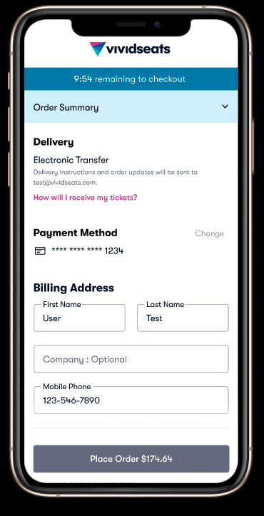
Notes:
Misc. Prototype notes/UX suggestions:
Note add card should be deactivated before full input – not tested
Place billing address on the same screen as ad new card - not tested – last screen auto advances to insurance section

Slide 37
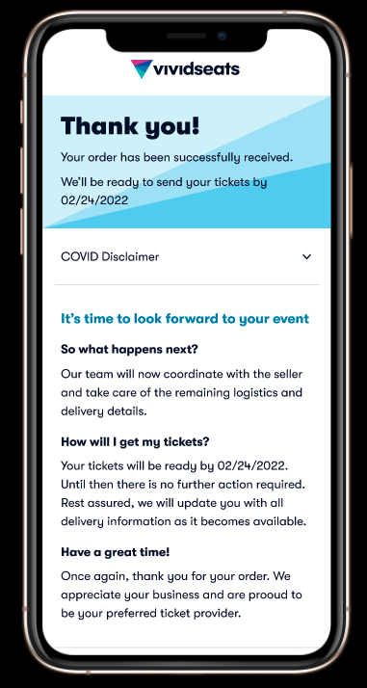
Notes:
Misc. Prototype notes/UX suggestions:
Note add card should be deactivated before full input – not tested
Place billing address on the same screen as ad new card - not tested – last screen auto advances to insurance section

Slide 38
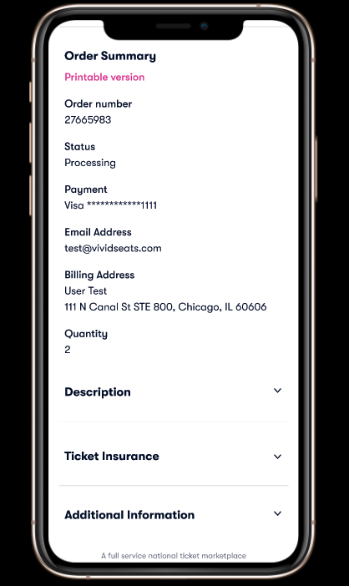
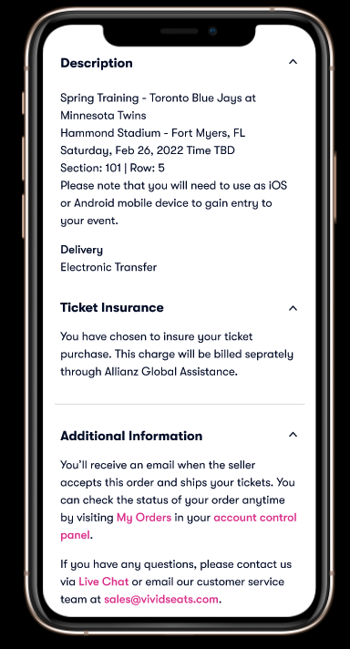
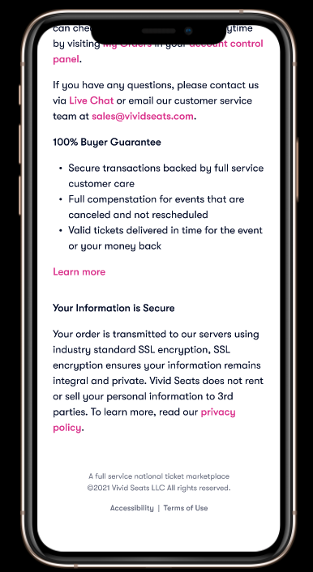
Notes:
Misc. Prototype notes/UX suggestions:
Note add card should be deactivated before full input – not tested
Place billing address on the same screen as ad new card - not tested – last screen auto advances to insurance section

Slide 39
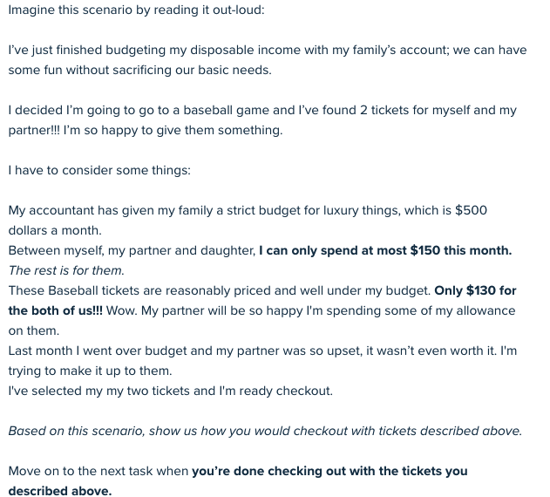
PRIMARY TASK CARD
First person “I”
Scenario:
User context (what where they just doing?)
Intent/Motivation
Game mechanics- A.K.A - Real World Constraints
Multi-player dynamics (family/friends)
Task Goal (stopping point, how the user thinks their successful)
“SHOW”
When to “move on”
4. Rorschach test Blue + Purple
CHECKOUT TASK
Notes:
Life is messy and not written down for you. So in some ways this is much easier than the real world. You don’t understand the game mechanics of your own life. Here they are neatly written down and can be used almost as a checklist.
Concsider that more market research on where the use is in the context of their life (before they arrive to our site) can make scenario scripting less detailed. However, then we must recruit exactly those samples which can delay testing needs.

Slide 40
TASK CARD 2
STORE FOR LATER - TASK

Slide 41
Appendix - B
Special Findings

Slide 42
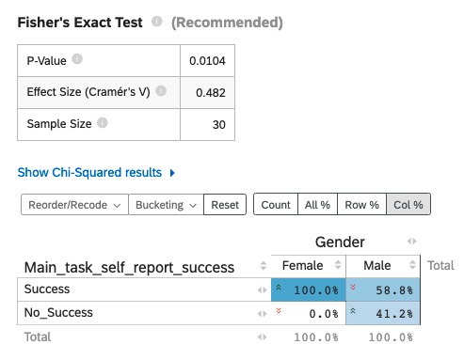
Identifying as male, is associated with less self-reported success.
HAPPINESS
ENGAGEMENT
ADOPTION
RETENTION
TASK SUCCESS
In line with previous research (Search A/B Competitive Analysis) Females tended to self-report success more than males in the checkout process.
So what is Gender associated with in this study?
On average, those who identified as females tended to do these things more than males:
Heard of or used Seat Geek
Refilled a Prescription
Interested in attending Concerts and were more loosely interested in sports
Agreed that the prices was more comfortable
Notes:
Just like a lot of indie films this story starts out boring…. This is the way it should be Feeling Successful = Feeling Easy? But this also means that for a small proportion of participants this was not the case; their feelings of success and ease of use were disjointed, which can be more frustrating than just feeling like it was hard and unsuccessful.

Slide 43
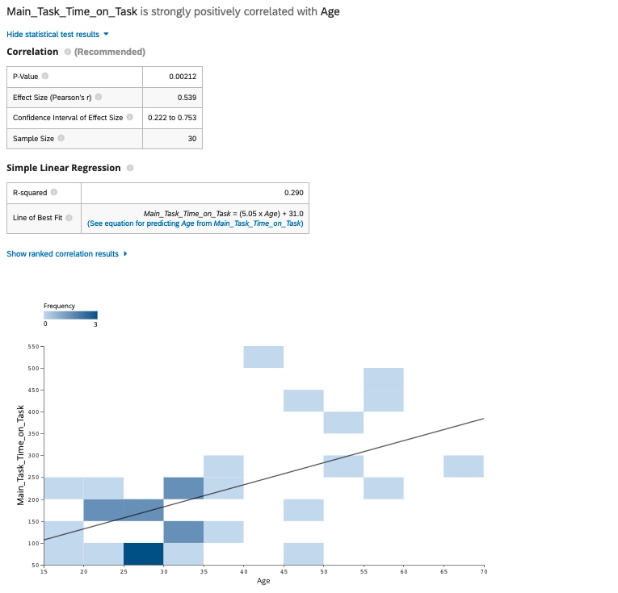
Time on Task is mostly associated with Age (p< 0.02, Large Effect.)
HAPPINESS
ENGAGEMENT
ADOPTION
RETENTION
TASK SUCCESS
For this study we are not interested in time on task average as a benchmark because data entry input was not required for the prototype.
What we are interested in is how this would change between participants and if this relationship would still hold after prototypes required data entry input.
What should be most important to note is that this time on task was not associated with self-reporting task success or self –reported ease of use.
Notes:
Other notable associations were engagement metrics like clicks, page views, and unique page views are related to time on task, inherently.

Slide 44
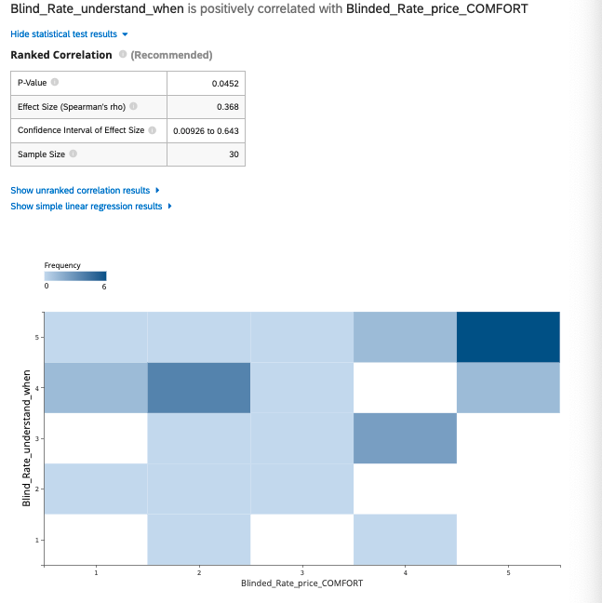
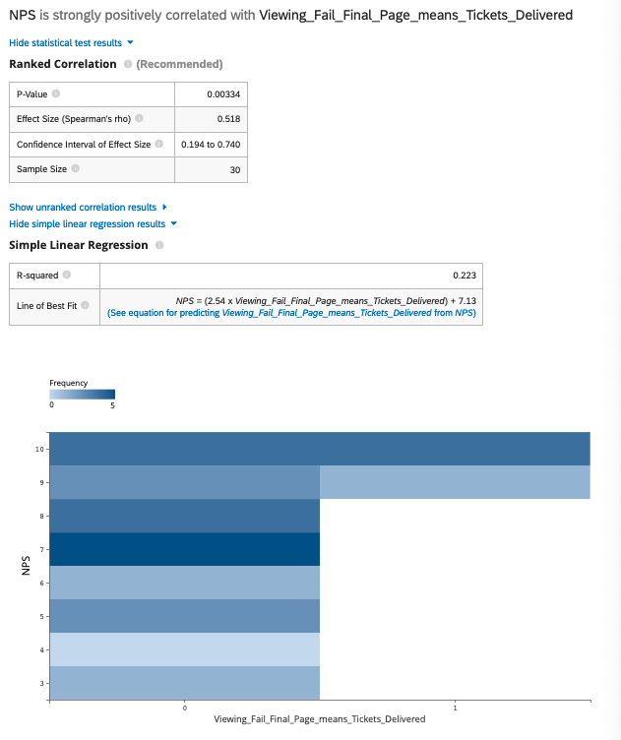

Slide 45
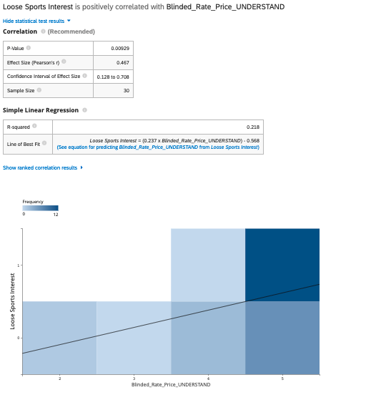
Being interested in other live events may give more price contextualizing experiences
For those personas who were interested in more than just attending live sporting events, their rating of understanding the price was much higher, on average.

